Slide 1

CEFR 101
Presented :
When: March 5, 2019 as part of a
professional learning series for FSL Leads in the province of Ontario
By: Staff in FSL Policy Implementation Unit
Field Services Branch
Ministry of Education of Ontario
Purpose: To assist FSL Leads in facilitating professional learning for FSL educators across the province of Ontario
Support for new FSL board leads

Slide 2

Land acknowledgments are a stepping stone to honouring broken treaty relationships.
Notes:
Recognition of traditional territory:

Slide 3

Objectives for today’s session
Increase knowledge about supports that exist within the ministry for FSL school board leads.
Have the opportunity to learn about essential documents, processes and resources related to the CEFR.
Brainstorm professional learning activities for the CEFR that can be adapted for use in all school boards.

Slide 4

Key information for new FSL leads
Notes:
This session is to ensure that as a new FSL lead in your board, you are aware of the CEFR, the DELF, and the Ontario DELF Centre” Many boards in Ontario are participating in the DELF this year, so there is a very real chance that you may be running the DELF testing session, not perhaps feeling confident about all of the moving parts.

Slide 5

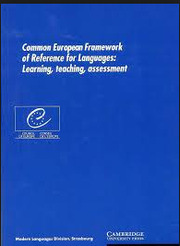

What is the Common European Framework of Reference (CEFR)?
Research-based framework
Neither a program nor a curriculum/syllabus
Informs practices for instruction and assessment
Notes:
As an FSL lead, you may have heard of the Common European Framework of Reference or the CEFR. But what is it? Why does it matter for French as a second language learners?
Different learners have different levels of language ability, but opinions on the level of language can be quite subjective. There needs to be a clear objective way to describe language skills. This is what the CEFR provides.
In Ontario, the CEFR presents a framework to inform practices for instruction and assessment for and as learning in the acquisition of any language. As always, the Ontario curriculum is the document by which we evaluate our students. FSL teachers use curriculum policy documents and the achievement chart to plan, teach and assess.
The CEFR is neither a program nor a curriculum/syllabus; it is a tool that describes the competences needed by second-language learners in order to be able to communicate effectively and is organized into six levels of proficiencies.

Slide 6
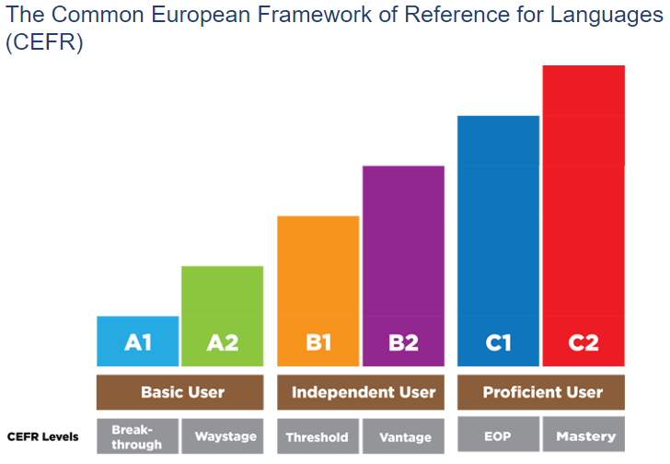
CEFR Levels
Notes:
The 6 levels describe competences of the second-language learner in five areas: spoken production, spoken interaction, listening, reading, and writing. In addition, they are described in terms of “can-do” statements.
In Ontario schools, we focus on the A1- B2 levels. In the elementary panel, the majority of our students work in the A2 level, depending on program, and individual language experience. In the secondary panel, based on the results of previous year’s DELF participation in Ontario, the majority of gr. 12 FSL students who elected to participate self-assessed at the B1 level.

Slide 7
Six levels of proficiency
CEFR Level | The learner can…
A1 | Comprehend and use familiar simple words and expressions.
A2 | Understand and communicate in frequently used isolated sentences in their immediate environment (e.g., shopping, life at school and family).
B1 | Understand the main points of everyday communication and deal with most situations that are familiar or of personal interest.
B2 | Understand concrete and abstract concepts and interact with a degree of ease and spontaneity in the target language
C1/C2 | Understand with ease virtually everything heard or read and express himself/herself spontaneously, fluently and precisely in complex situations.
Notes:
Here is a simplified description to give you a basic understanding of the levels. (downloads area)
At the A1 level, students can understand and use very basic expressions to satisfy concrete needs.
They can introduce themselves and ask others questions about personal details. They can interact simply as long as the other person speaks slowly and clearly.
At the A2 level, students can understand frequently used expressions in most intermediate areas such as shopping, family, employment, etc. They complete tasks that are routine and involve a direct exchange of information and describe matters of immediate need in simple terms.
At the B1 level students understand points regarding family, work, school or leisure-related topics.
They can deal with most travel situations in areas where the language is spoken and create simple texts on topics of personal interest. They can describe experiences, events, dreams, and ambitions, as well as opinions or plans.
Finally at the B2 level- students understand the main ideas of a complex text. They can spontaneously interact without too much strain for either the learner or the native speaker. They can produce a detailed text on a wide range of subjects. This is the level that we wish our students in Ontario obtain by the end of their FSL studies in Grade 12.
It is important to note that there is no correlation between the levels of proficiency of the CEFR and grade level. There is also no correlation between the levels of the CEFR and the levels and categories of the provincial achievement chart. Learners use CEFR descriptors to help them identify their current proficiency level and to set goals to move forward. Students need to develop their “self-assessment skills to enable them to assess their own learning, set specific goals, and plan next steps for their learning”.

Slide 8

Activity
Notes:
Activity 1
(use global and English Scales)
What are the key words for each level?
What do these key words tell us about student proficiency in FSL programs? (speech acts, asset based, progression)

Slide 9
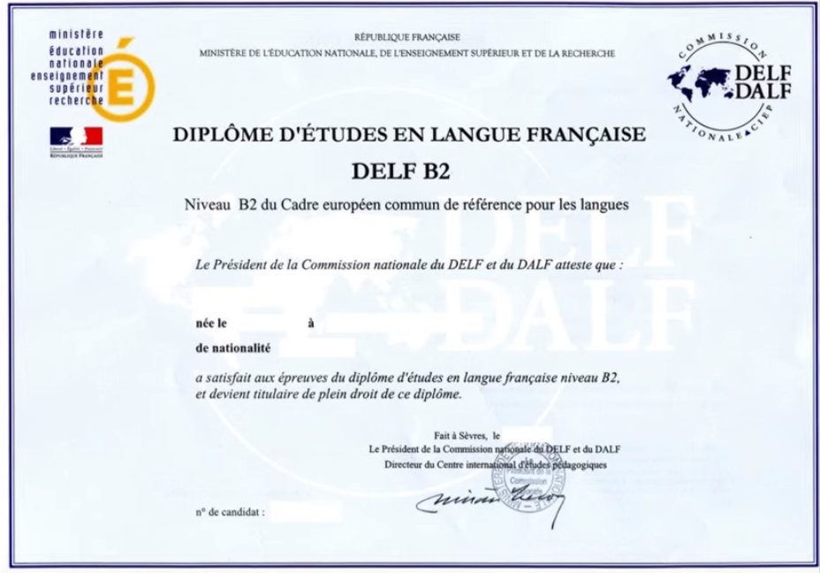
What is the DELF?
Notes:
The DELF (Diplôme d'Etudes en Langue Française) is an official qualification awarded by the French Ministry of Education to certify the competency of candidates from outside France in the French language. These certificates are valid for life. This year in Ontario, most school boards have indicated an interest in participating in or “challenging” the DELF. The test is marked by certified “correcteurs” who are individuals who are trained specifically for this task. One of the important rules for the test is that students may not have their own teacher mark their tests. The DELF exams are managed by DELF centres, which are accredited by the French Ministry of Education through the French Embassy, and which coordinate the administration of the exams according to the standards of the Centre international d’études pédagogiques (CIEP)
Here is a short clip that will explain from a school board’s perspective what the DELF is, and from student candidates, how they perceive the test and its importance.
https://delf-dalf.ambafrance-ca.org/candidate-testimonials

Slide 10

Why take the DELF?
A DELF diploma offers:
International recognition of French proficiency
A testimonial to a students’ success in learning French
Advantages for postsecondary education and the job market.
Notes:
Today French is an official language in almost 50 countries, including Canada. It is spoken by more than 200 million people on five continents.
Here are some reasons why students are interested in challenging the DELF:
It is a life-long certification.
It is based on the same international standard used in 164 countries.
It is a recognition of the students’ accomplishments to date on the path to French proficiency.
It represents an official document, recognized internationally, that enriches the candidate's school or professional portfolio.
It is recognized internationally by francophone postsecondary institutions, including a growing number in Canada.

Slide 11


Ontario DELF Centre
Nancy Rancourt- Manager
Denis Cousineau- Coach
delfontario@gmail.com
1-888-569-3353
Notes:
The DELF scolaire is offered through a variety of ways across the province. Many English-language school boards have worked directly with DELF Centres (there are 2 currently) in Ontario to offer the DELF scolaire to students. The growing interest in the DELF scolaire across Ontario has led to the creation of the Ontario DELF Centre, allowing more students enrolled in Grade 12 French as a Second Language (FSL) courses to participate. The centre is run by Nancy Rancourt of the Algoma District School Board through ACPI.
The Ontario DELF Centre is not intended to replace existing DELF centres operated by school boards (Ottawa and Thunder Bay). They will continue to operate independently as before. School boards who previously worked with an existing DELF centre operated by a school board will have the choice to continue with that DELF centre or join the Ontario DELF Centre to offer the DELF.
The new, virtual Ontario DELF Centre will streamline the financial and administrative supports available to school boards leads responsible for the DELF, while maintaining school board’s autonomy to make decisions related to offering the DELF.

Slide 12

The role of the Ontario DELF Centre
Liaise with the Centre international d'études pédagogique (CIEP) (the public institution for educational and training cooperation within the French Ministry of National Education, Higher Education and Research), and the French Embassy;
Pay CIEP fees (school boards using this centre will not be invoiced) for the May 2019 DELF scolaire session for students enrolled in Grade 12 FSL courses;
Communicate with school board DELF leads;
Enter student results and information into the DELF centre software;
Support FSL professional learning (e.g., CEFR provincial and regional initiatives)
Notes:
The role of the Ontario DELF Centre will be to…

Slide 13
The role of school boards
Coordinate and fund the training for a sufficient number of examiners;
Make all student arrangements related to the exam, including collecting parent permissions, organizing the location and materials for the exams;
Manage all communication with teachers, students and families; and,
Work with the Ontario DELF Centre for the administrative aspects of the DELF.
Notes:
The role of school boards working with the Ontario DELF Centre will be to…

Slide 14
Funding for the DELF
Number of students enrolled in Grade 12 FSL courses writing the DELF in 2017/2018 | Amount
0 (No prior experience with the DELF) | $5,000
1-50 | $5,000
51-100 | $10,000
101+ | $15,000
Notes:
All school boards that have indicated an intention to participate in the DELF this year will received will funding to support the internal costs (teacher release time, etc.) for the DELF. This is based on the number of students that participated in DELF last year as per the chart on the screen.
If school boards have opted to work with the Ontario DELF centre, will not have to pay any other fees to the Ontario DELF Centre. If your board is working with another center, there could be costs (administrative fees, etc.) that will be charged. As the Ontario DELF Centre currently only offers administration of the Spring session and only for Gr. 12 students, any other testing time or grade of student would need to be addressed through another Centre.
For the 2018/2019 school year, the Ontario DELF Centre will support the participation of students enrolled in Grade 12 FSL courses during the May 2019 DELF session. Funding provided by the ministry to school boards participating with the Ontario DELF Centre is intended to cover teacher release time and other internal costs. These school boards will not be invoiced by the Ontario DELF Centre for CIEP or administrative fees. For example, funding for 2018/19 will be allocated based on the number of students writing the DELF in 2017/2018.

Slide 15
Activity
Notes:
Activity 2
Scenario-
If you are a new FSL lead, you are told that your school board will continue to participate in the DELF. You however, have not been part of the DELF before. What are your questions? For those of you that have been part of the process, what might be some of the key that a new FSL lead would need to know?
Debrief:
When does the DELF take place?
Which DELF Centre will you be working with?
How many correcteurs do you have? What is their status? (end date?)
Who ran the session last year? Do you have a connection to a formateur in your region if you have questions?
Where do the students take the test? Book Early!
What technical requirements do I need?
What scheduling perimeters are there?
Are there specific rules for when each level can be tested?
What communication is sent out? Through whom? (Parent and Principal)
How much does this cost? Where do we get the funds?
How many students challenged the DELF last year? How many this year? What grade are the students in?

Slide 16
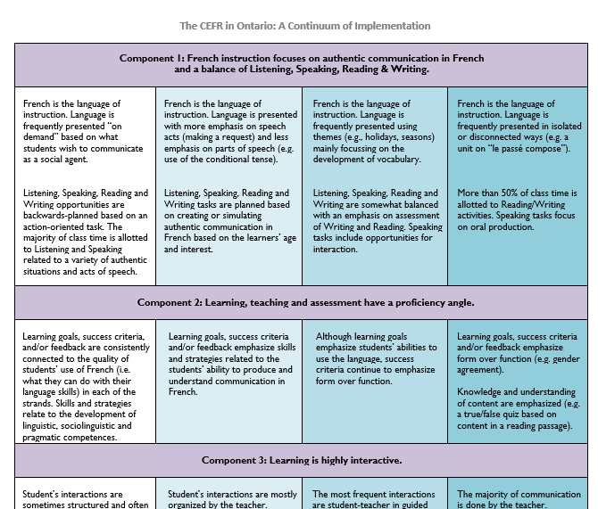

CEFR Continuum of Implementation
https://sites.google.com/teltgafe.com/cefr-ontario
Notes:
The Ontario CEFR initiatives page can be found at the link provided on the screen. The purpose of this website is to share professional learning materials from past CEFR provincial initiatives with Ontario's English-language school boards, to support effective planning, instruction and assessment in French as a Second Language (FSL) programs.
https://sites.google.com/teltgafe.com/cefr-ontario
On the website, you will find the co-created "continuum of implementation" document and an important description of its context. This document has been very well received throughout school boards in Ontario and is available in your download document pod. So let’s take a closer look.

Slide 17
Why create a continuum of implementation?
What is it?
The continuum provides clear, specific, and shared descriptions of what a new program or practice looks like.
It focuses on the key components of a program or practice.
The continuum describes variations for each component of a new program in terms of the actions and behaviors that are ideal, acceptable, and unacceptable.
It helps teachers who are new to a school understand program expectations.
Notes:
The continuum was co-created by participants in a provincial webinar in June 2016, with the intent to describe more clearly and more coherently their current practice, and set objectives and priorities for upcoming professional learning inspired by the CEFR. Professional learning related to the CEFR has been underway in all Ontario school boards since 2010.
Here are the key components- (on screen)
The continuum of implementation is available in both English and French and can be adapted and refined based on the users needs. The chart was created keeping in mind that many important stakeholders in supporting effective FSL classroom practices may not themselves have training in the CEFR or speak French.

Slide 18
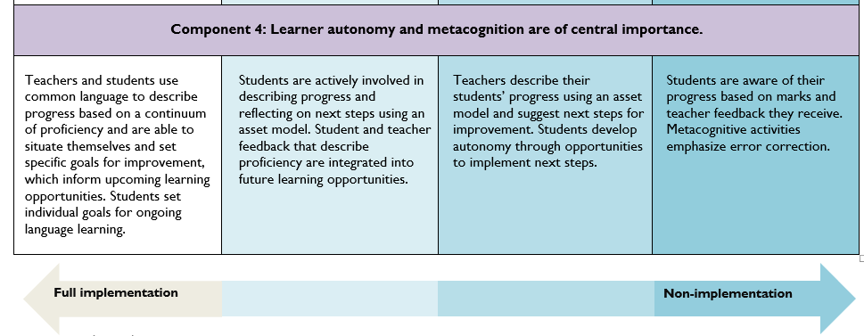
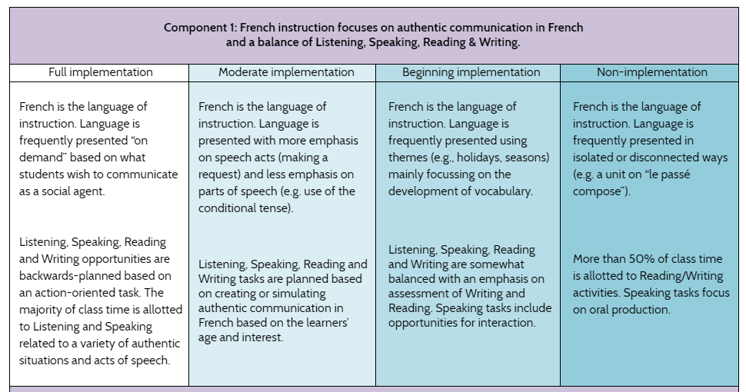
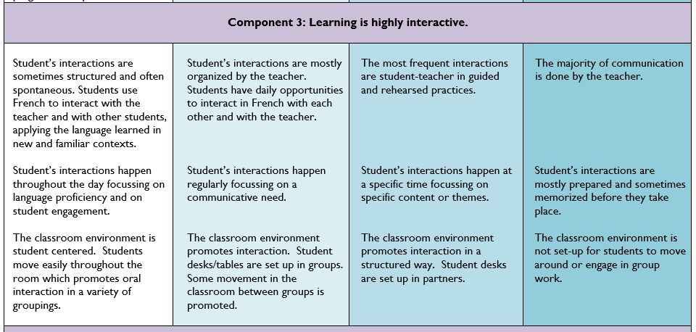
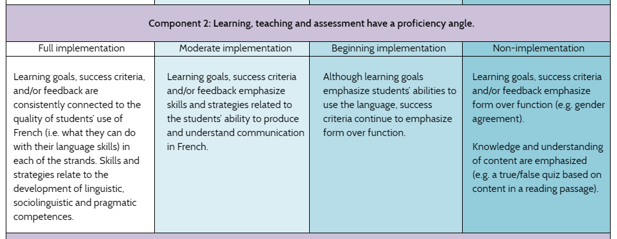
Notes:
Let’s take a closer look at each part. The first component focuses on responding to the following key concepts:
Language use presented “on demand”.
Communication as a social agent
Backwards planning based on authentic situations.
The use of action-oriented tasks.
Component 2-
Success criteria, and feedback focused on the quality of student’s French
Providing feedback in regard to the development of linguistic, pragmatic and sociolinguistic competences.
Component 3-
Creating spontaneous conversation.
Creating student centered classroom.
Application of language learned in new and familiar contexts.
Finally, Component 4-
The use of common language to describe progress.
Students setting goals for themselves.
Goals informing learning opportunities.

Slide 19
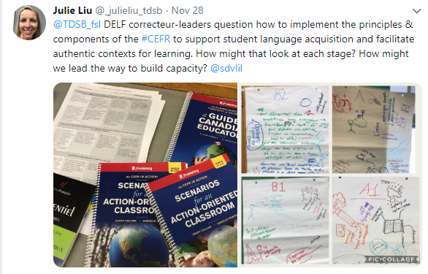
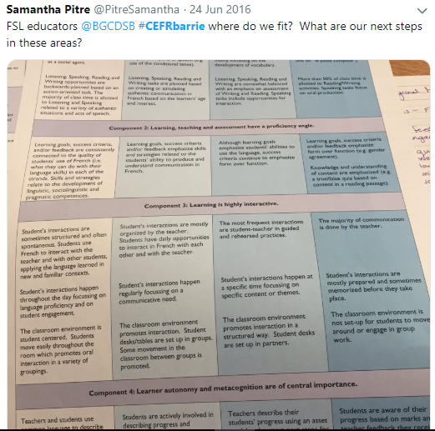
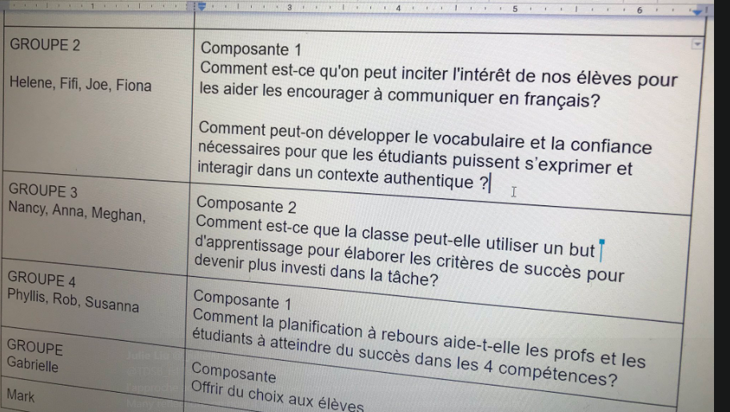
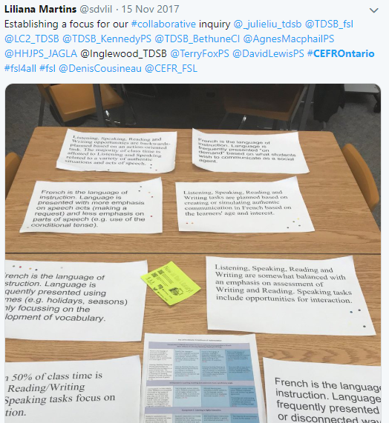
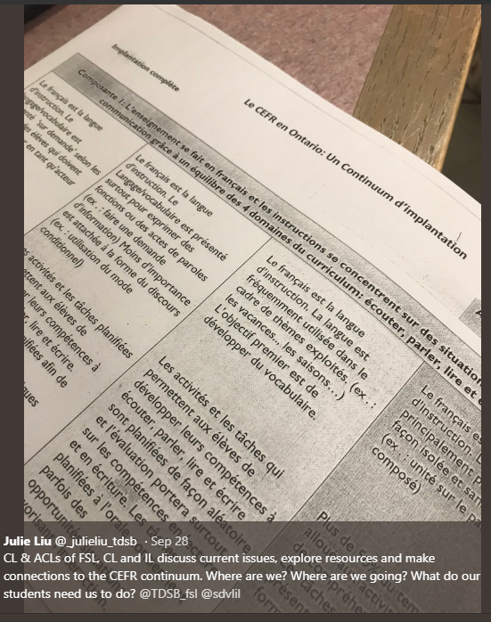
How are school boards using the continuum?
Collaborative inquiries
Notes:
Schools boards have had a very positive response to the continuum of implementation. Here are some social media posts that represent how they are using this tool. (click to reveal)
On the Ontario CEFR initiatives website each of the 4 components of the continuum have been broken down to include activities that the province offered during CEFR provincial seminars for your use and can be adapted easily to suit your school board’s needs.
Ultimately, the continuum is an effective tool for the collection and analysis of school board data
regarding evidence of implementation of second language pedagogy.
How might you use the continuum in your school boards to support your board FSL three year plan?

Slide 20
Activity
Notes:
Activity 3
Group brainstorm
How might you use the continuum to inform professional learning?
How might you use the continuum to inform your three year FSL plan?

Slide 21






